Slide 1
Assignment 7
TCAD sprocess simulation TA: Pooja Sharma

Slide 2
p-n junction fabrication process flow
P-type Si
P-type Si
P-type Si
P-type Si-wafer (100) plane
Deposit SiO₂
Transfer pattern and make mask by photolithography
P-type Si
n-type
n-type
P-type Si
P-type Si
Anisotropic etching of SiO2
Ion implantation for n-type Si
Annealing after implantation

Slide 3
metal
metal
n-type
n-type
n-type
P-type Si
P-type Si
P-type Si
Remove the remaining SiO2 by isotropic etching
N-contact metal deposition
Anisotropic etching of the metal
 | metal
 | n-type
P-type Si

Slide 4

TCAD Sprocess Simulation
(0,0)
(1,0)
X
1.Grid definition
# 1D Grid definition in x direction
line x location= 0.0 spacing=1.0<nm> tag=SiTop
line x location=50<nm> spacing=10<nm> line x location=100<nm> spacing=20<nm> line x location=500<nm> spacing=50<nm>
line x location=1200<nm> spacing=100<nm> tag=SiBottom
# 1D Grid definition in y direction
line y location=0.0 spacing=50<nm> tag=Left
line y location=1000<nm> spacing=50<nm> tag=Right
(0,1.2)
(1,1.2)
Y

Slide 5
TCAD Sprocess Simulation
2. Define simulation domain and initial parameters
(1,0)
(0,0)
# Initial simulation domain
region Silicon xlo=SiTop xhi=SiBottom ylo=Left yhi=Right
# Initial doping concentration in the region defined
init concentration=1e+17<cm-3> field=Boron wafer.orient=100
# Global Mesh settings for automatic meshing in newly generated layers.
#This strategy is used when there is change in initial geometry due to
#deposit, oxidation and etching
(0,1.2)
(1,1.2)
mgoals min.normal.size=2<nm> normal.growth.ratio=1.4 accuracy=1e-5
Y

Slide 6
TCAD Sprocess Simulation
P-type Si
3. Oxide deposition
deposit material= {Oxide} type=isotropic time=1 rate= {0.15}
grid remesh
4. Implant mask
mask name=implant_mask segments= {0<um> 0.425<um> 0.575<um> 1.0<um> }
5. Anisotropic oxide etching
etch material= {oxide} type=anisotropic time=1 rate= {0.17} mask=implant_mask grid remesh
P-type Si
# save the structure file after etching
struct tdr=1_pn_oxide_etch_before_implant ;

Slide 7
TCAD Sprocess Simulation
Grid refinement
refinebox Silicon min= {0.0 0.4} max= {0.2 0.6} \
xrefine= {0.01 0.01 0.01} yrefine= {0.01 0.01 0.01} grid remesh
Ion implantation (n-type dopants)
implant Phosphorus energy=10<keV> dose=0.7e14<cm-2> tilt = 0
Diffusion of n-type dopants
diffuse temperature=1060<C> time=1.2<s>
# save the structure after implantation and diffusion struct tdr=2_pn_after_implant_diffusion ;
n-type
P-type Si
Ion implantation
n-type
P-type Si
Diffusion of dopants

Slide 8
TCAD Sprocess Simulation
9. Isotropic oxide etch
etch material= {Oxide} type=isotropic time=1 rate= {0.17} grid remesh
# save structure file after oxide etch
struct tdr=3_pn_after_imp_diff_oxide_etch ;
n-type
P-type Si
Remove the remaining SiO2 by isotropic etching
10. n-contact deposition
metal
n-type
deposit material= {Aluminum} type=isotropic time=1 rate= {0.07} grid remesh
#save structure after contact deposition
struct tdr=4_pn_after_metal_depos ;
P-type Si
N-contact metal deposition

Slide 9
TCAD Sprocess Simulation
11. Metal etching for n-contact
mask name=contacts_mask1 left=0.425<um> right=0.575<um>
metal
n-type
P-type Si
etch material= {Aluminum} type=anisotropic time=1 rate= {0.08} mask=contacts_mask1 grid remesh
Anisotropic etching of the metal
12. Define contacts
contact name = "n" box Aluminum adjacent.material = Ambient \ xlo = -0.071 xhi = -0.069 ylo = 0.425 yhi = 0.575
contact name = "p" box silicon adjacent.material = Ambient\ xlo = 1.19 xhi = 1.21 ylo = 0.0 yhi = 1
# save final structure
struct tdr = 5_pn_final_structure
 | metal
 | n-type
P-type Si

Slide 10
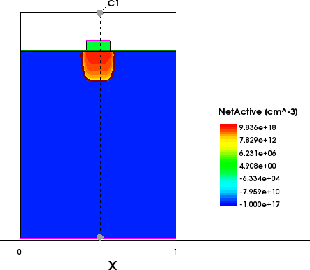
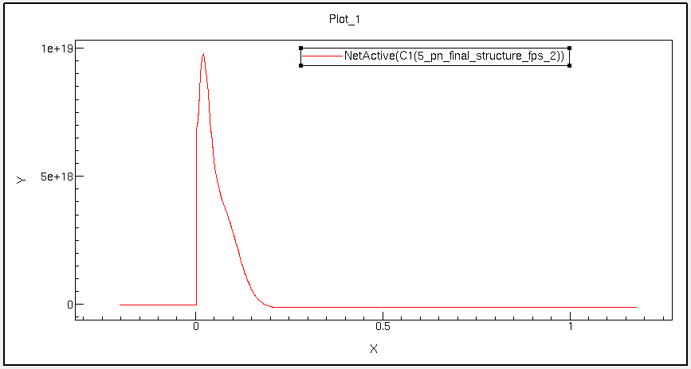
TCAD Sprocess Simulation

Slide 11
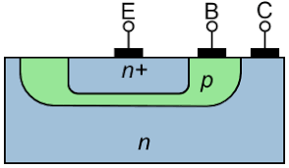
Assignment 7
pn junction diode and BJT Sprocess simulation
Create a pn junction by implanting Phosphorus on a Boron doped ( 5e14 cm⁻³) Si substrate. Check the impact of (a) implant energy (use 10, 20 and 40keV) and (b) implant dose (use 1e12, 5e14 and 5e16 cm⁻² for comparison) on the peak concentration and junction depth by plotting the net-active concentration (N_{D}-N_{A}) along the device depth. Explain your observations.
In question 1 use Arsenic instead of Phosphorus and compare the results. Explain the observations.
Create BJT n⁺p⁻n with collector - base junction depth ~ 300 nm and base - emitter junction depth ~200 nm. Make n+ and p region doping as uniform as possible with Phosphorus concentration, ND = 1e20 cm⁻³ and Boron concentration, NA = 1e14 cm⁻³, by changing the parameters such as implant dose, implant energy, diffusion or annealing time and temperature etc. Assume background doping to be ND = 1e16 cm⁻³ for n⁻ region. Plot the net-active concentration both on linear and log scale.
(Note: Calculate dose from doping using standard formula and required junction depths.)

Slide 12
Assignment 7
pn junction diode sdevice simulation
In the given n⁺p⁻n junction structure, plot the energy band diagram (E_{C}, E_{V}, E_{F}) along the junctions under the application of (a) in common Emitter configuration (b) common base configuration and (c) common collector configuration. Also, plot the quasi Fermi level in these cases.
Plot the IV curves of the BJT in common emitter as well as common base configuration.
Note: Required material is given in the slides for more details refer to the sprocess user guide attached with this assignment.

Slide 13
TCAD Sdevice Simulation
# use these files to get the band diagram and IV characteristics of the given device structure
File {
Grid= "5_pn_final_structure_fps.tdr" Current= "bottom.plt"
Plot= Output=
"bottom.tdr" "bottom.log"
}
Electrode {
{ Name= "n" Voltage= 0.0 }
{ Name= "p" Voltage= 0.0 }
}
Physics {
Mobility ( DopingDep ) EffectiveIntrinsicDensity(BandGapNarrowing(oldSlotboom)) Recombination (Avalanche(CarrierTempDrive)
Band2Band (E2) SRH)
# turn them on or off to see the effect of each recombination mechanism
}

Slide 14
TCAD Sdevice Simulation
Plot {
Doping DonorConcentration AcceptorConcentration BandGap BandGapNarrowing ElectronAffinity ConductionBandEnergy ValenceBandEnergy eQuasiFermiEnergy hQuasiFermiEnergy
eDensity hDensity EffectiveIntrinsicDensity IntrinsicDensity ElectricField/Vector
Potential SpaceCharge
Current/Vector eCurrent/Vector hCurrent/Vector CurrentPotential * for visualizing current lines eMobility hMobility
SRHRecombination AugerRecombination TotalRecombination SurfaceRecombination
eLifeTime hLifeTime
ComplexRefractiveIndex QuantumYield
}

Slide 15
TCAD Sdevice Simulation
Math {
Extrapolate Iterations= 8 SubMethod= ParDiSo Method= Blocked
}
Solve{
Coupled { Poisson }
Coupled { Poisson Electron Hole }
Quasistationary ( InitialStep = 1e-3 MaxStep = 0.1 MinStep = 1e-6 Goal { Name = "p" Voltage =2}){ Coupled { Poisson Electron Hole } }
NewCurrentFile="IV_sweep_"
Quasistationary ( InitialStep = 1e-3 MaxStep = 0.001 MinStep = 1e-6 Goal { Name = "p" Voltage =-10})
{ Coupled { Poisson Electron Hole } }
}

